Slide 1


Slide 2


Slide 3
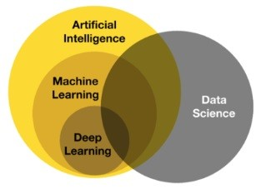
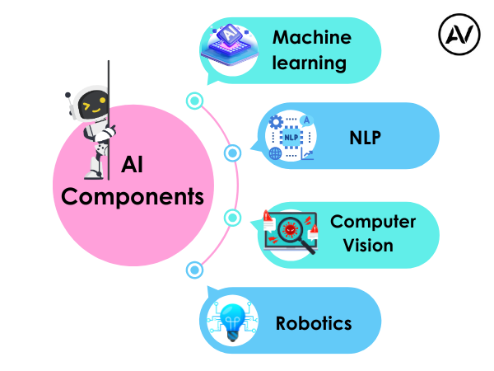
https://ellow.io/components-of-ai/

Slide 4
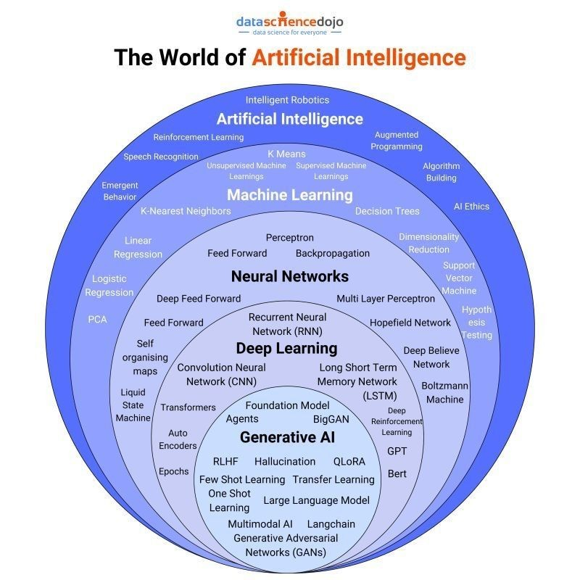
Algorithms and models

Slide 5
Artificial Intelligence (AI) refers to the simulation of human intelligence in machines that are designed to think, learn, and make decisions. AI encompasses a wide range of technologies, including rule-based systems, expert systems, and machine learning algorithms.
Key Features of AI:
Automation of tasks that require human intelligence.
Ability to learn from data and improve over time.
Applications across various domains, including healthcare, finance, and robotics.

Slide 6
AI vs ML vs DL
Artificial Intelligence (AI):
The broadest concept, referring to machines that can perform cognitive functions similar to humans.
Encompasses ML, DL, and rule-based systems.
Examples: Virtual assistants, autonomous vehicles, and recommendation systems.
Machine Learning (ML):
A subset of AI that enables machines to learn patterns from data without explicit programming.
Uses statistical models and algorithms like decision trees, regression, and clustering.
Examples: Fraud detection, predictive analytics, and spam filters.
Deep Learning (DL):
A specialized subset of ML that relies on deep neural networks.
Requires large datasets and computational power.
Examples: Image recognition, natural language processing, and speech recognition.
Applications of AI
AI has transformed multiple industries by enabling automation and improving decision-making. Some major applications include:
Healthcare: Disease diagnosis, personalized medicine, robotic surgeries.
Finance: Fraud detection, algorithmic trading, risk assessment.
Retail: Recommendation systems, demand forecasting, customer sentiment analysis.
Autonomous Systems: Self-driving cars, drones, robotics.
Natural Language Processing: Chatbots, virtual assistants, language translation.

Slide 7
Conventional AI vs Generative AI (GenAI)
Conventional AI:
Focuses on classification, prediction, and rule-based decision-making.
Uses structured datasets for training.
Examples: Spam filters, customer service chatbots, recommendation engines.
Generative AI (GenAI):
A type of AI that creates new content, such as text, images, and music.
Uses models like GANs (Generative Adversarial Networks) and transformers (e.g., GPT, DALL-E).
Examples: AI-generated art, chat-based content generation, and text-to-image synthesis.
Future of AI
The future of AI is expected to bring significant advancements and challenges:
AI-Augmented Creativity: More sophisticated generative models for content creation.
Explainable AI (XAI): Enhancing transparency and trust in AI decision-making.
Ethical AI Development: Addressing biases, privacy concerns, and responsible AI use.
AI in Edge Computing: Deployment of AI models on edge devices for real-time processing.
Superintelligence and AGI: Theoretical advancements toward artificial general intelligence (AGI) with human-like reasoning capabilities.
AI continues to evolve, driving innovation and transforming industries worldwide.

Slide 8
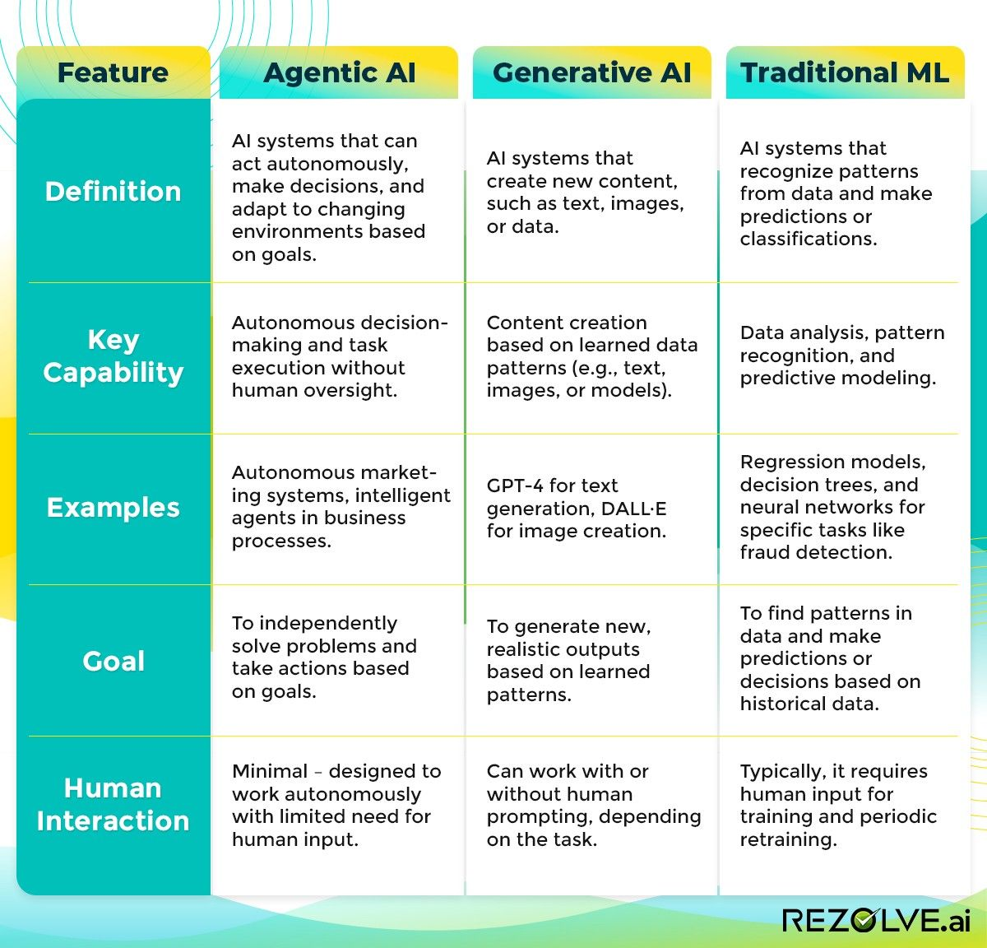

Slide 9
Key components of a Deep Learning syllabus:
1. Fundamentals of Neural Networks:
Introduction to Artificial Neural Networks (ANNs)
Perceptron model
Activation functions (sigmoid, ReLU, tanh)
Backpropagation algorithm
Gradient descent optimization
2. Deep Learning Architectures:
Multi-Layer Perceptron (MLP)
Convolutional Neural Networks (CNNs)
Recurrent Neural Networks (RNNs)
Long Short-Term Memory (LSTM)
Generative Adversarial Networks (GANs)
Autoencoders
3. Advanced Optimization Techniques:
Momentum, RMSprop, Adam optimizer, and Learning rate scheduling.
4. Practical Implementation with Libraries:
TensorFlow, PyTorch, Keras, Data preprocessing and augmentation, and Model training and evaluation metrics.
5. Applications of Deep Learning:
Computer Vision
Image classification
Object detection
Image segmentation
Natural Language Processing (NLP)
Text classification
Sentiment analysis
Machine translation
Speech Recognition
Time Series Analysis
6. Ethical Considerations:
Bias in data and models, Privacy concerns, Explainability and interpretability, and Responsible AI practices.
Important Points to Consider:
Prerequisites:
A solid understanding of linear algebra, calculus, probability, and programming skills (usually Python) are required to fully grasp deep learning concepts.
Hands-on Projects:
Implementing various deep learning models on real-world datasets is crucial for gaining practical experience.
Stay Updated:
Deep learning is rapidly evolving, so continuous learning about new research and techniques is important.

Slide 10
https://medium.com/towards-data-science/what-the-hell-is-perceptron-626217814f53
Introduction to DL
Introduction to Deep Learning
Perceptron Model
Introduction to Tensorflow and Keras
Introduction to Types of Neural Networks
Artificial Neural Network Deep Dive
Activation Functions in NN
Single Layered ANN
Multiple Layered ANN
Loss Functions
Optimization Technique
Regularization Techniques
CallBacks

Slide 11
Introduction to Deep Learning
Deep Learning (DL) is a subset of Machine Learning that utilizes artificial neural networks with multiple layers to learn complex patterns in data. It enables high-level feature extraction from raw data and is the foundation for many modern
AI applications.
Key Aspects of Deep Learning:
Multi-layered neural networks (deep networks) that extract hierarchical features.
Requires large datasets and significant computational power (e.g., GPUs, TPUs).
Performs exceptionally well in tasks like image recognition, natural language processing, and speech synthesis.

Slide 12
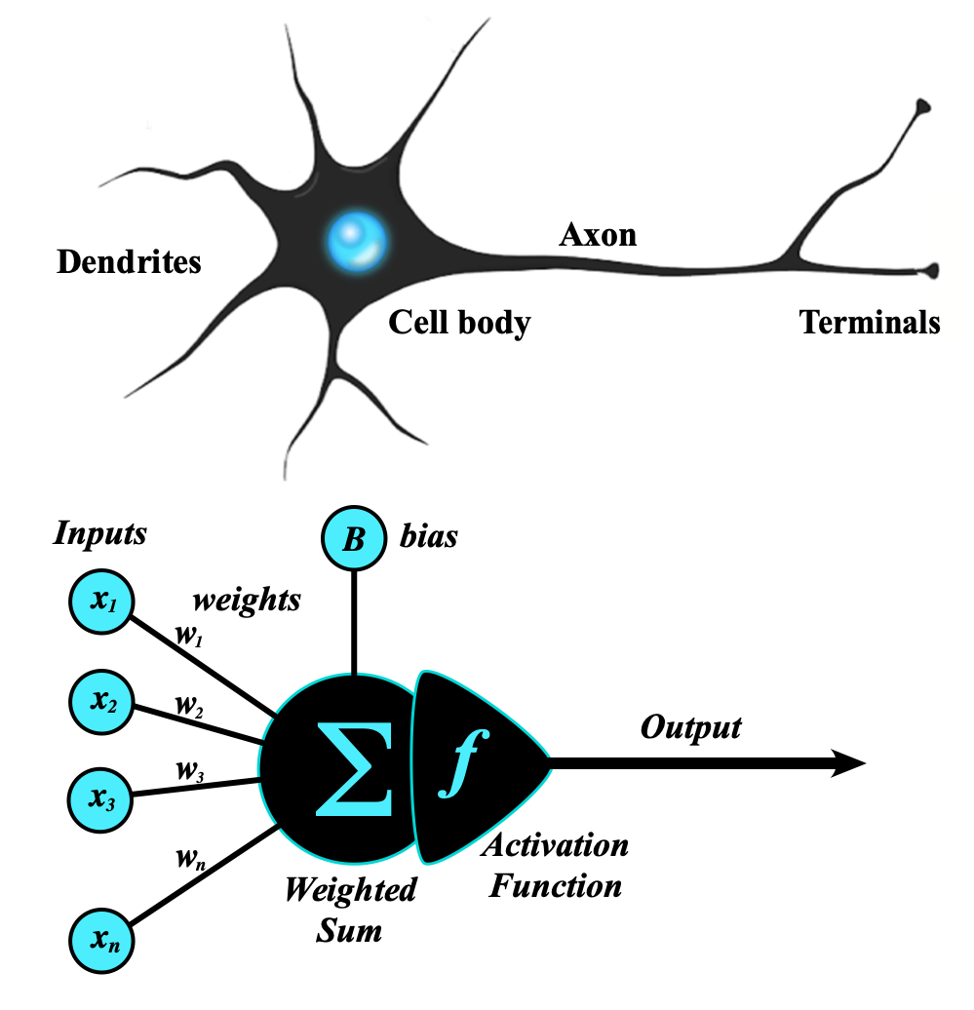
Artificial Neural Network
An artificial neural network (ANN) is a computational network (a system of nodes and the interconnection between nodes) inspired by biological neural networks, which are the complex networks of neurons in human brains (see Figure).
The nodes created in the ANN are supposedly programmed to behave like actual neurons, and hence they are artificial neurons.
The Perceptron was invented in 1957 by Frank Rosenblatt at the Cornell Aeronautics Laboratory. Based on the first concepts of artificial neurons, he proposed the “Perceptron learning rule“.
Perceptron Model
The perceptron is the simplest form of an artificial neural network and serves as the building block of more advanced models.
Components of a Perceptron:
Inputs: Feature values from the dataset.
Weights: Assigned to each input to signify importance.
Summation Function: Computes the weighted sum of inputs.
Activation Function: Applies a threshold to determine output.
https://www.geeksforgeeks.org/neural-networks-a-beginners-guide/
https://s.mriquestions.com/what-is-a-neural-network.html

Slide 13
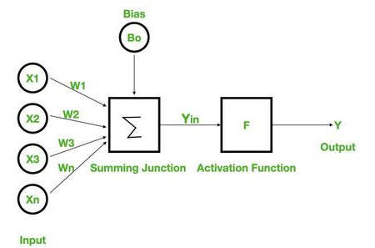
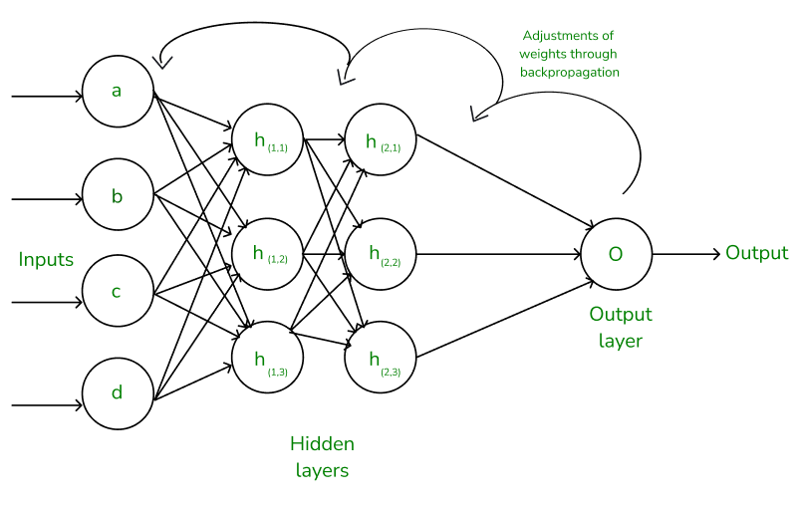
Types of Perceptron Models:
Single-layer perceptron: Can only solve linearly separable problems.
Multi-layer perceptron (MLP): Can solve non-linear problems using multiple layers.
Neural Networks Architecture:
the basic elements of the network's architecture.
made of three core layers:
Input layer
Hidden layers
Output layer

Slide 14
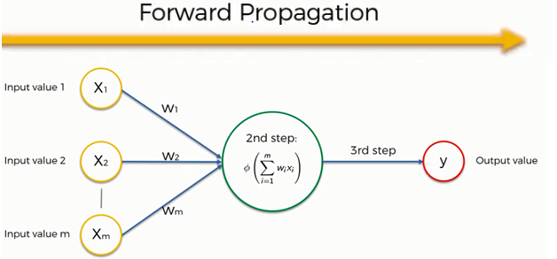
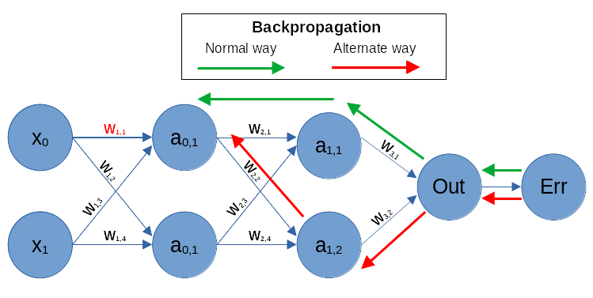
Working of Neural Networks
Forward Propagation
input
calculation -->then apply activation func
output
Backpropagation
Loss Calculation
Gradient Calculation
Weight Update
https://www.guru99.com/backpropogation-neural-network.html
Feedforward vs. Backpropagation
https://www.geeksforgeeks.org/backpropagation-in-neural-network/

Slide 15
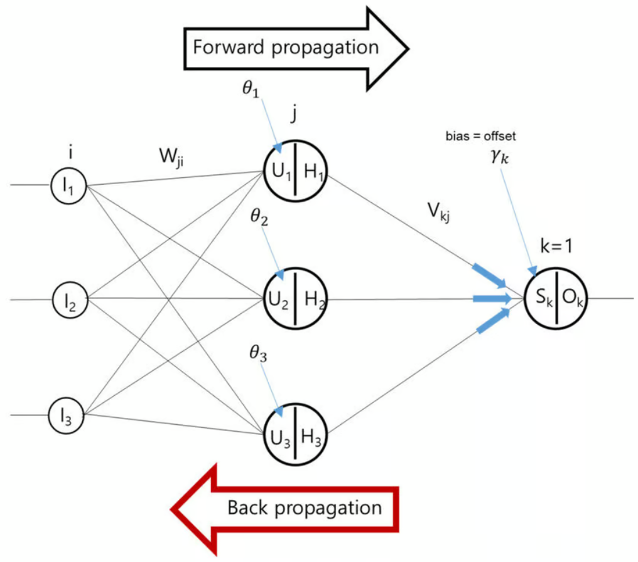
Terms Neural Networks Architecture:
features
weights
bias
USE IN ANN
for non linearity in neural network
activation functions
for error calculations
mse,mae, logloss
for optimizations
gradient descent/ optimzer
4. Evaluation Matrix
classification
regression

Slide 16
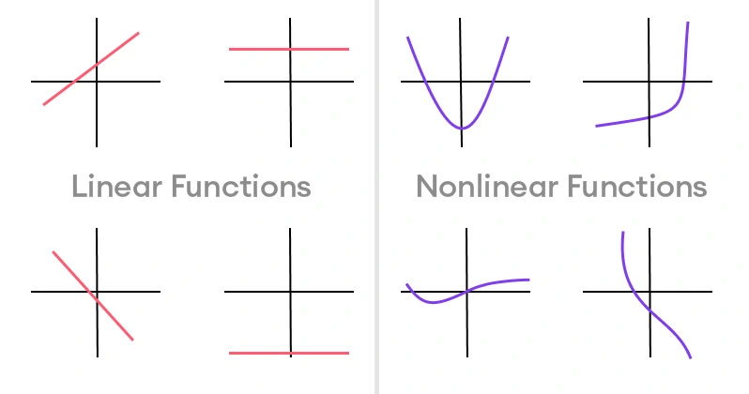
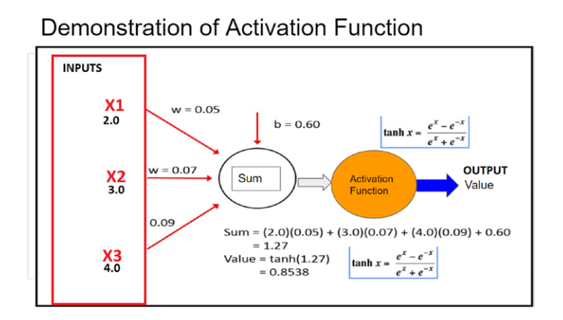
Activation functions
https://www.superannotate.com/blog/activation-functions-in-neural-networks

Slide 17
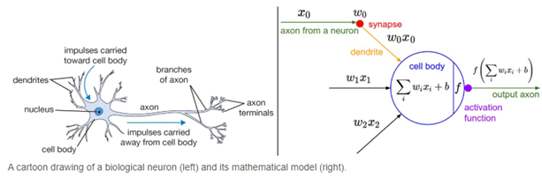
What is a Neural Network Activation Function?
An Activation Function decides whether a neuron should be activated or not. This means that it will decide whether the neuron’s input to the network is important or not in the process of prediction using simpler mathematical operations.
The role of the Activation Function is to derive output from a set of input values fed to a node (or a layer).
Activation functions play a crucial role in neural networks by introducing non-linearity, enabling the model to learn and represent complex patterns. Without activation functions, a neural network behaves like a linear model, limiting its ability to capture intricate relationships in data.

Slide 18
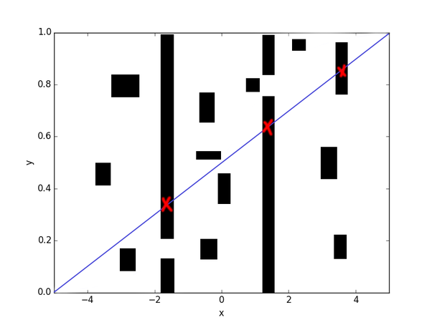
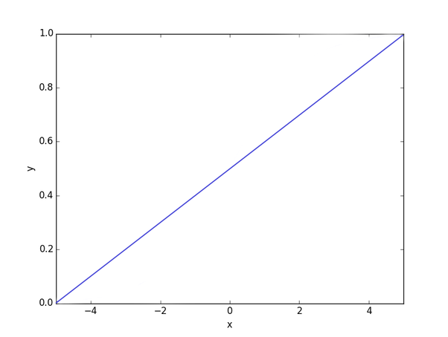

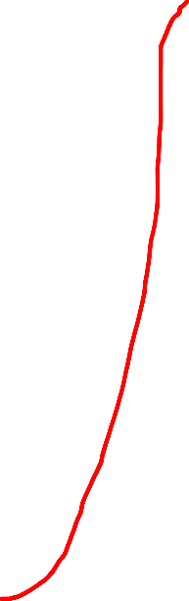

Sometimes it’ll be more difficult. You’ll have to go through very specific spots and avoid others:
Why Neural Networks Need Activation Functions?
Imagine that a neural network is a hose:
It takes water (takes some input), carries it somewhere (modifies your input), and pushes water out (produces some output).
Without an activation function, your hose will act more like a steel pipe: fixed and inflexible. Sometimes that’s good enough. Nothing wrong with using a pipe to deliver your water:
An inflexible steel pipe just won’t fit no matter how you rotate it. An ctivation function comes in handy here, because it allows your function to be more flexible.
In this case, a neural net with an activation function would act like a plastic garden hose. You can bend it to your specific needs and carry your water to a lot more places that are impossible to reach with a steel pipe:

Slide 19
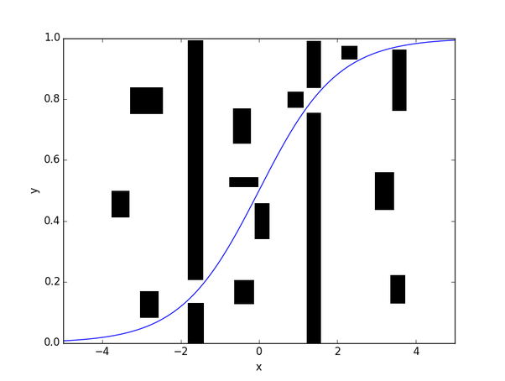
Neural networks require activation functions for several key reasons:
Non-linearity: Activation functions introduce non-linearities into the network. Without them, a neural network would essentially behave like a linear model, regardless of how many layers it has. This means it would be unable to learn complex patterns in the data.
Output Control: Activation functions help control the output of a neuron. For example, in binary classification tasks, using a sigmoid or softmax activation function can produce outputs that can be interpreted as probabilities.
Gradient Propagation: During training, neural networks rely on backpropagation to update weights. Activation functions help shape the loss surface and can influence the speed and stability of training. Some functions, like ReLU (Rectified Linear Unit), help mitigate issues like vanishing gradients, allowing models to learn faster and perform better.
Thresholding: Certain activation functions (like step functions) can act as thresholds, allowing the model to decide whether to activate a neuron based on whether the input exceeds a certain value. This can help in decision-making processes.
Diversity of Outputs: Different activation functions can create diverse output distributions, allowing the neural network to learn a variety of tasks effectively. For instance, ReLU is often used in hidden layers for its simplicity and efficiency, while softmax is commonly used in output layers for multi-class classification.
So, the purpose of an activation function is to add flexibility to your hose (non-linearity to your neural net).
Overall, activation functions are crucial for enabling neural networks to learn complex relationships and make accurate predictions.

Slide 20
Why do we need non-linear activation functions in a neural network?
To understand why non-linear activation functions are needed, think of neural nets in a mathematical sense. In its simple form, what we are doing is passing some input X and generating some output Y.
More mathematically,
The architecture of the neural network can be thought of as a function which takes an input X and generates some output Y.
f(X)−>Y or f(X)−>Y
So, a problem is just a mathematical function which we are trying to approximate using a neural net. You can read more about universal approximation theorem over here.
If only linear activation functions are used, then the combination of these functions is another linear activation function.
For example:
Let the net input at first layer be as follows:
Z[1]=W[1]∗X+b[1]Z[1]=W[1]∗X+b[1] Equation (1)
After passing through an activation function:
a[1]=g(Z[1])a[1]=g(Z[1])Equation (2)
Now, net input at second layer is:
Z[2]=W[2]∗a[1]+b[2]Z[2]=W[2]∗a[1]+b[2]Equation(3)
If the activation function is linear then, a[1]=c∗Z[1]a[1]=c∗Z[1]

Slide 21
That is, some multiple (c) of the net input would be the resultant output after passing through a linear activation function.
For simplicity, let c = 1 and substitute the value of a[1]a[1]in equation 3.
We get,
Z[2]=W[2]∗Z[1]+b[2]Z[2]=W[2]∗Z[1]+b[2]
which is,
Z[2]=W[2]∗W[1]∗X+b[1]+b[2]Z[2]=W[2]∗W[1]∗X+b[1]+b[2]From equation 1
This result can be written as:
Z[2]=W′X+B′Z[2]=W′X+B′
The result is just another linear function and this process will continue even in further layers.
Simple linear functions cannot approximate every function f(X). Hence, we require non-linear activation functions in neural nets.
https://www.quora.com/Why-do-neural-networks-need-an-activation-function

Slide 22
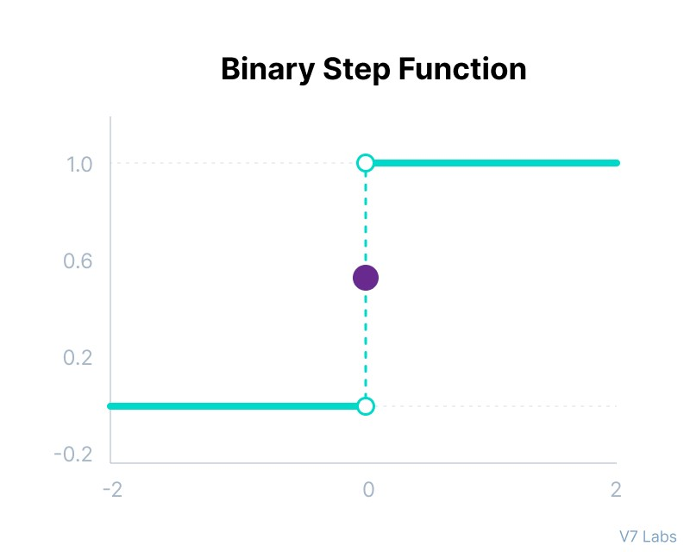
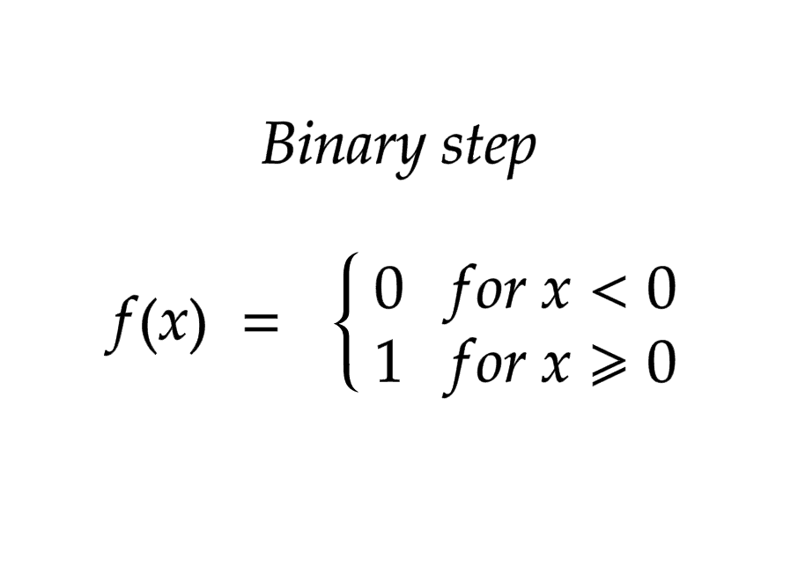
3 Types of Neural Networks Activation Functions
1. Binary Step Function
Binary step function depends on a threshold value that decides whether a neuron should be activated or not.
The input fed to the activation function is compared to a certain threshold; if the input is greater than it, then the neuron is activated, else it is deactivated, meaning that its output is not passed on to the next hidden layer.
Adv: Suitable for basic binary classification:
Simple threshold-based decision:(0,1)
Limitations:
Non-differentiable: This means it cannot be efficiently trained using standard backpropagation algorithms, which rely on calculating gradients.
No non-linearity: The step function introduces no non-linearity to the network, limiting its ability to learn complex patterns.
It cannot provide multi-value outputs—for example, it cannot be used for multi-class classification problems.
Mathematically it can be represented as:
such as it not being differentiable and it can’t backpropogate signals.

Slide 23
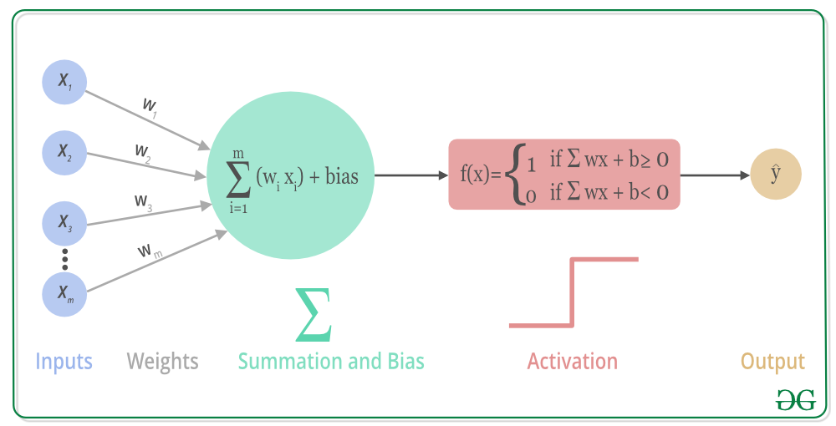
Example use cases:
Simple image classification:
If you need to classify images as either "cat" or "dog" with a very simple decision boundary, a binary step function could be used in the output layer.
Anomaly detection:
Identifying data points that significantly deviate from a norm by setting a threshold and classifying them as "anomaly" (1) or "normal" (0).
Alternatives to binary step function for most neural network applications:
Sigmoid function:
Outputs values between 0 and 1, making it suitable for probability estimations in binary classification.
ReLU (Rectified Linear Unit):
More commonly used due to its efficient gradient calculation and ability to handle complex patterns.
def binary_step(x, threshold=0):
"""
Binary step function: returns 1 if x is greater than or equal to the threshold,
otherwise returns 0.
"""
return 1 if x >= threshold else 0
# Example usage
input_value = 0.5
result = binary_step(input_value, threshold=0.2) # result will be 1
print(result)

Slide 24
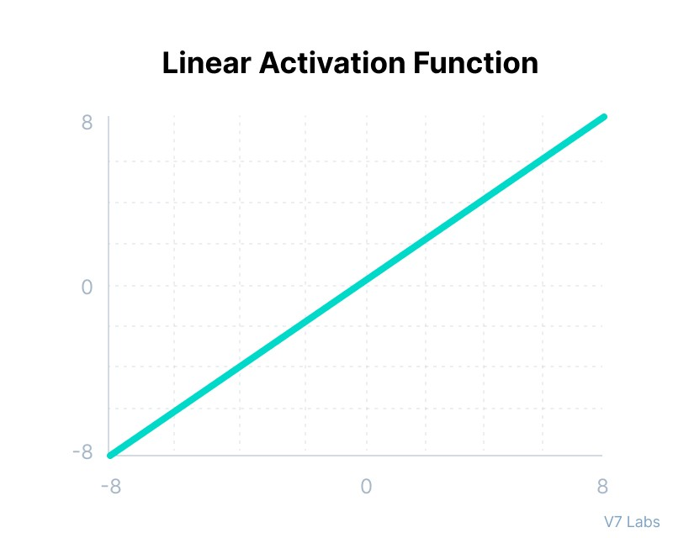
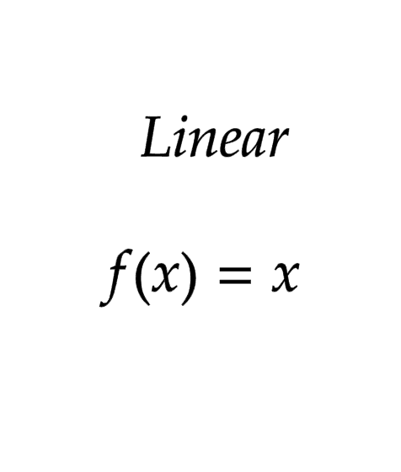
2. Linear Activation Function
The linear activation function, also known as "no activation," or "identity function" (multiplied x1.0), is where the activation is proportional to the input.
The function doesn't do anything to the weighted sum of the input, it simply spits out the value it was given.
Use case: Most useful in the final layer of a regression neural network where the output needs to be a continuous numerical value.
Mathematically it can be represented as:
OPTIONAL (Piecewise Linear (PL)

Slide 25
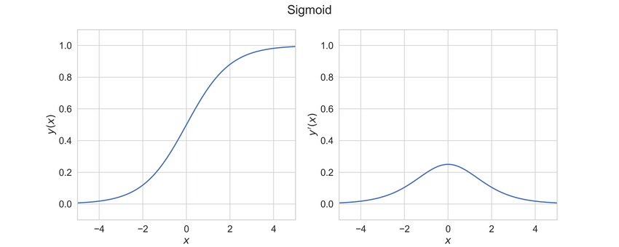
However, a linear activation function has two major problems :
It’s not possible to use backpropagation as the derivative of the function is a constant and has no relation to the input x.
All layers of the neural network will collapse into one if a linear activation function is used. No matter the number of layers in the neural network, the last layer will still be a linear function of the first layer. So, essentially, a linear activation function turns the neural network into just one layer.
Why not use linear activation in other layers?
No non-linearity: Since the linear function doesn't introduce any non-linearity, using it in hidden layers would limit the network's ability to learn complex patterns in data, which is typically achieved with non-linear activation functions like ReLU or sigmoid.
Sigmoid activation function y(x) and its derivative y (x).

Slide 26
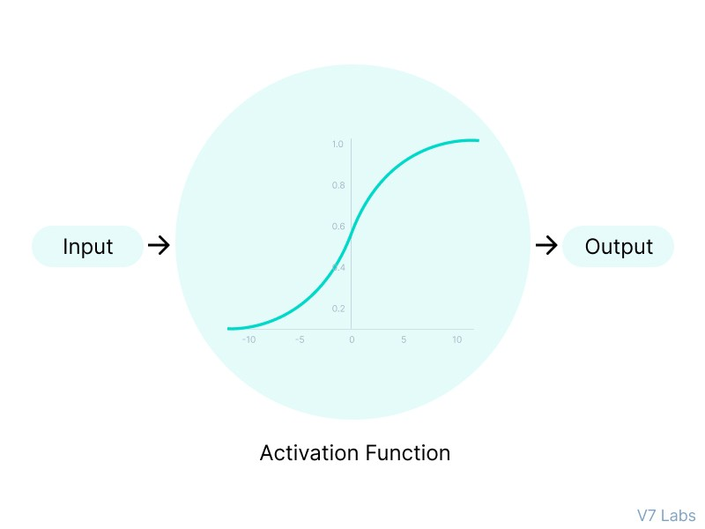
3. Non-Linear Activation Functions
The linear activation function shown above is simply a linear regression model.
Because of its limited power, this does not allow the model to create complex mappings between the network’s inputs and outputs.
Non-linear activation functions solve the following limitations of linear activation functions:
They allow backpropagation because now the derivative function would be related to the input, and it’s possible to go back and understand which weights in the input neurons can provide a better prediction.
They allow the stacking of multiple layers of neurons as the output would now be a non-linear combination of input passed through multiple layers. Any output can be represented as a functional computation in a neural network.
Now, let’s have a look at ten different non-linear neural networks activation functions and their characteristics.

Slide 27
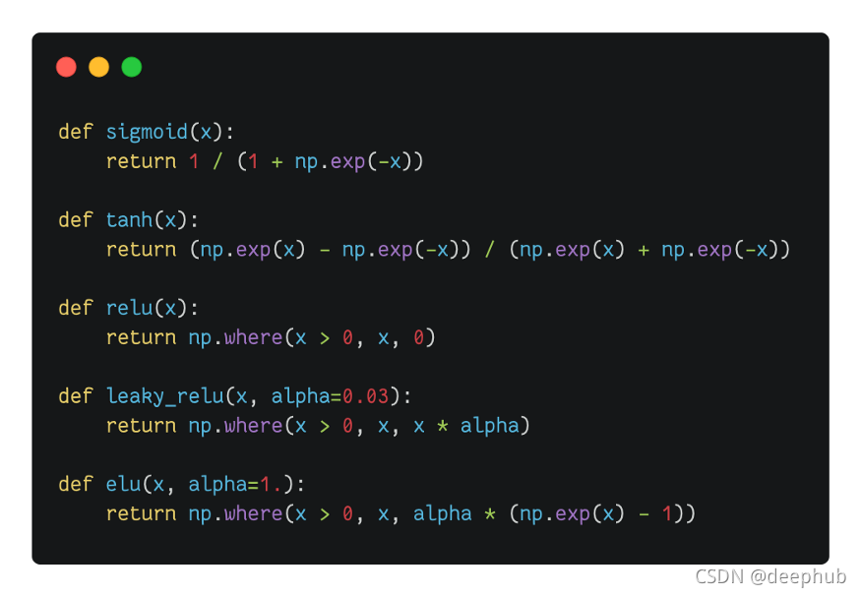
TYPES ON NON-LINEAR ACTIVATIONS
Sigmoid / Logistic Activation Function
Tanh Function (Hyperbolic Tangent)
ReLU Function
Leaky ReLU Function
Parametric ReLU Function
Exponential Linear Units (ELUs) Function
Softmax Function
OPTIONAL:-(Swish,Gaussian Error Linear Unit (GELU), Scaled Exponential Linear Unit (SELU),
https://www.datacamp.com/tutorial/introduction-to-activation-functions-in-neural-networks
https://www.v7labs.com/blog/neural-networks-activation-functions

Slide 28
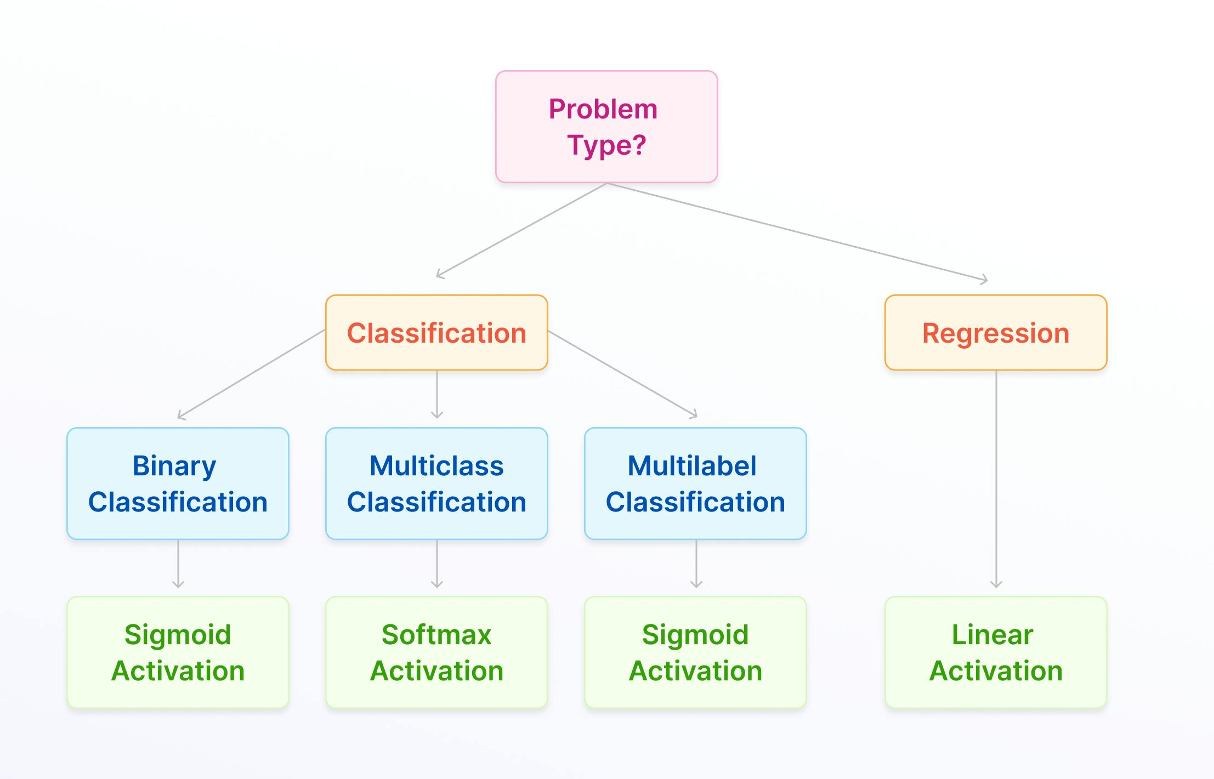
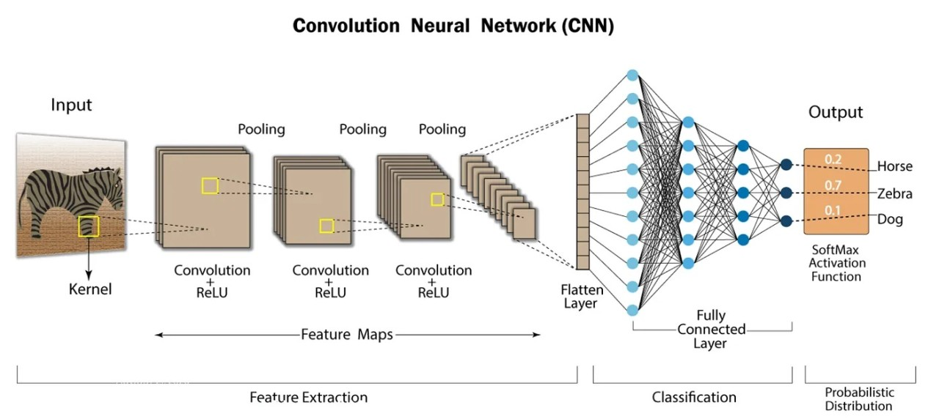

Slide 29
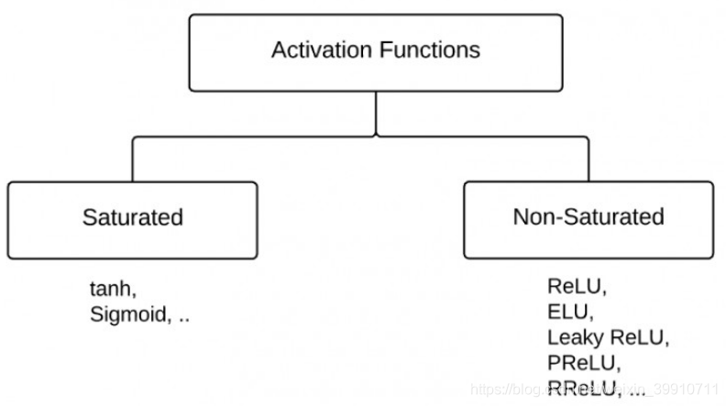
Activation Function Saturation & Unsaturation: Explained
1. What is Saturation in Activation Functions?
Saturation occurs when an activation function outputs values that are very close to its limits, leading to very small gradients (almost zero).
When neurons saturate, they stop learning because their gradients vanish during backpropagation.
This is a major problem in deep networks, slowing down or stopping training.
Examples of Saturating Activation Functions:
🔴 Sigmoid: Outputs in the range (0,1). When inputs are very large or small, gradients become almost zero.
🔴 Tanh: Outputs in the range (-1,1). When inputs are extreme, gradients also vanish.
Why is Saturation Bad?
❌ Causes vanishing gradient problem → Harder to train deep networks.
❌ Leads to slow learning or neurons becoming "inactive".
❌ Can make optimization unstable, especially in deep layers.

Slide 30
2. What is Unsaturation in Activation Functions?
Unsaturation means the activation function does not have regions where gradients vanish.
This allows strong gradient flow and faster learning in deep networks.
Activation functions that do not saturate are preferred for modern deep learning architectures.
Examples of Unsaturated Activation Functions:
✅ ReLU: No saturation for positive inputs (but zero for negatives → "dying ReLU" issue).
✅ Leaky ReLU & PReLU: Allow small negative gradients, preventing saturation.
✅ Swish & GELU: Smooth and non-saturating, making them effective in deep learning.
Why is Unsaturation Good?
✅ Prevents vanishing gradients, helping deep networks learn efficiently.
✅ Improves training speed and convergence.
✅ Works well in deep architectures like ResNets, Transformers, GANs, and CNNs.
How to Overcome Saturation?
✔ Use ReLU-based functions (ReLU, Leaky ReLU, PReLU, Swish, GELU).
✔ Apply Batch Normalization to keep inputs in an optimal range.
✔ Use better weight initialization (e.g., Xavier or He initialization).
✔ Avoid deep Sigmoid/Tanh networks unless necessary (e.g., LSTMs).
Would you like a visual comparison of saturated vs. unsaturated activations? 🚀

Slide 31
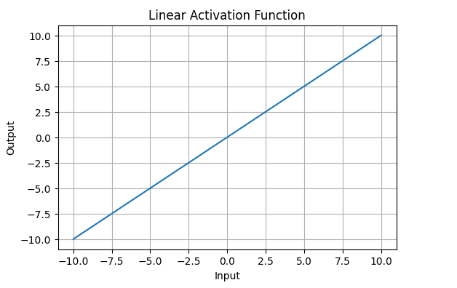
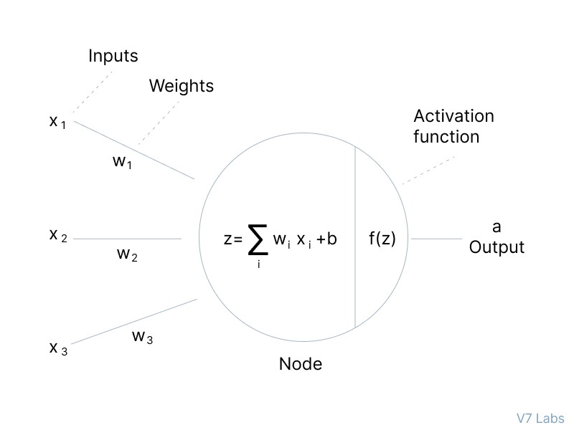
Linear Activation Functions
Linear Activation Function resembles straight line define by y=x. No matter how many layers the neural network contains, if they all use linear activation functions, the output is a linear combination of the input.
The range of the output spans from (−∞ to +∞)(−∞ to +∞).
Linear activation function is used at just one place i.e. output layer.
Using linear activation across all layers makes the network’s ability to learn complex patterns limited.
Linear activation functions are useful for specific tasks but must be combined with non-linear functions to enhance the neural network’s learning and predictive capabilities.

Slide 32
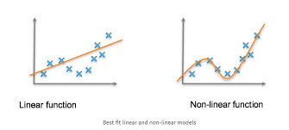
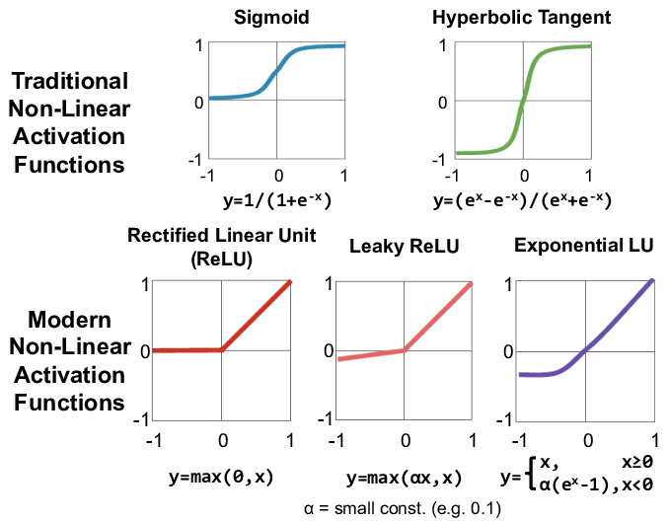
Non Linear Activations
The linear activation function shown above is simply a linear regression model.
Because of its limited power, this does not allow the model to create complex mappings between the network’s inputs and outputs.
Non-linear activation functions solve the following limitations of linear activation functions:
They allow backpropagation because now the derivative function would be related to the input, and it’s possible to go back and understand which weights in the input neurons can provide a better prediction.
They allow the stacking of multiple layers of neurons as the output would now be a non-linear combination of input passed through multiple layers. Any output can be represented as a functional computation in a neural network.
Now, let’s have a look at ten different non-linear neural networks activation functions and their characteristics.

Slide 33
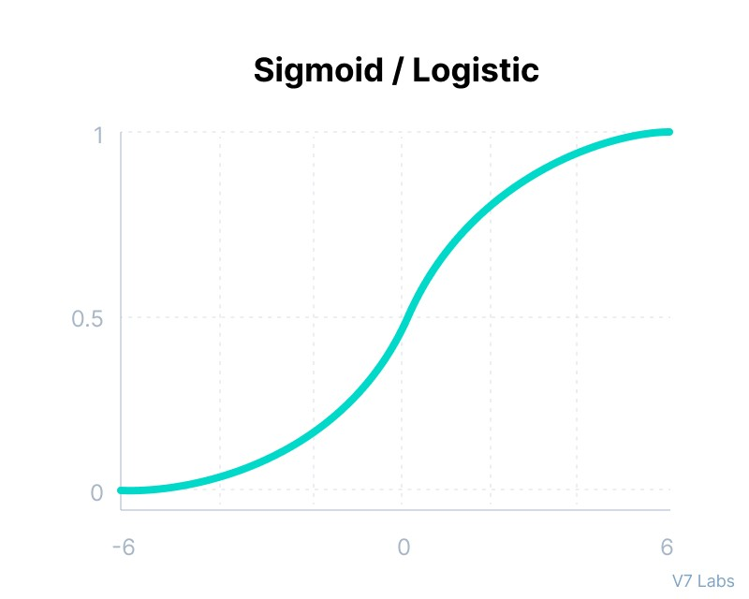
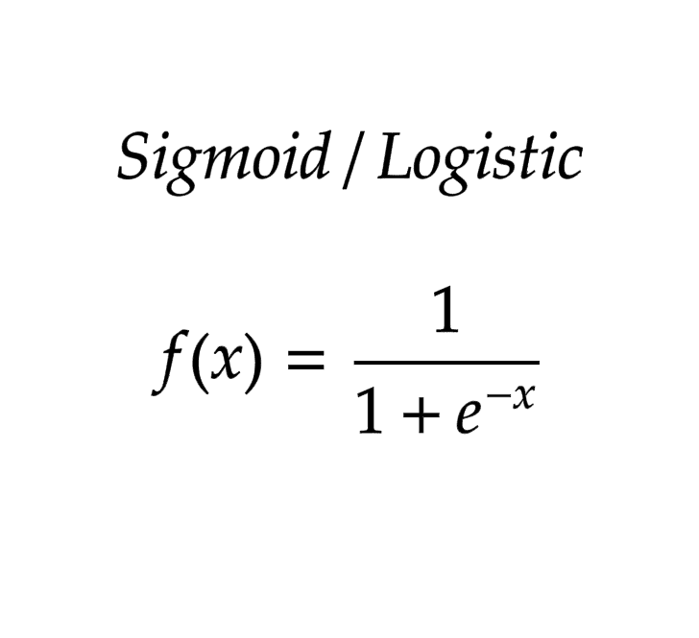
1. Sigmoid / Logistic Activation Function
takes any real value as input and outputs values in the range of 0 to 1.
squashing the inputs to a value between 0 and 1, making it perfect to model probability
The larger the input (more positive), the closer the output value will be to 1.0, whereas the smaller the input (more negative), the closer the output will be to 0.0.
Here’s why sigmoid/logistic activation function is one of the most widely used functions:
It is commonly used for models where we have to predict the probability as an output. Since probability of anything exists only between the range of 0 and 1, sigmoid is the right choice because of its range.
The function is differentiable and provides a smooth gradient, i.e., preventing jumps in output values. This is represented by an S-shape of the sigmoid activation function.
Mathematically it can be represented as:
The outputs can be easily interpreted as probabilities, which makes it natural for binary classification problems.

Slide 34
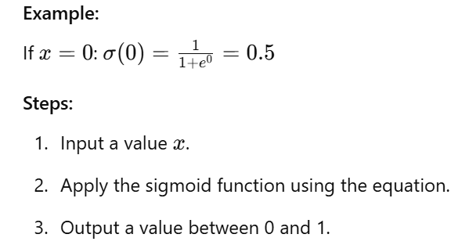
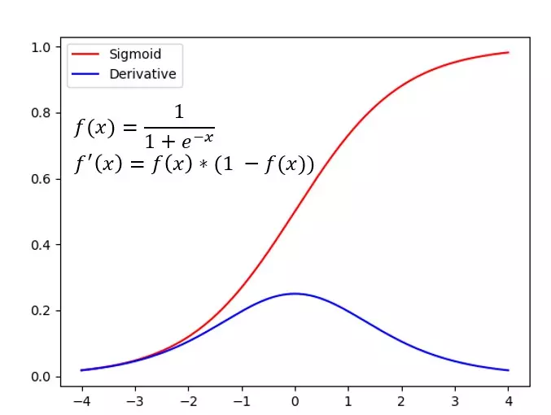
Real-World Example:
Used in binary classification problems (e.g., spam email detection).
Advantages:
Smooth gradient.
Outputs in a specific range (0 to 1).
Probabilistic interpretation.
Disadvantages:
Vanishing gradient problem. (“kill” the gradients.)
Computationally expensive due to exponentiation,Which can slow down the neural network training process.
How to Improve:
Use alternative activation functions like ReLU for hidden layers.
Where to Use:
Binary classification tasks.
Output layers requiring probabilities.
How to Use:
In a neural network framework like TensorFlow:
import tensorflow as tf
layer = tf.keras.layers.Dense(1, activation='sigmoid')
It is differentiable but saturates quickly because of the boundedness leading to a vanishing gradient when used in a deep neural network. Exponential computation is costly which compounds when you have to train a model with hundreds of layers and neurons.
https://medium.com/towards-data-science/fantastic-activation-functions-and-when-to-use-them-481fe2bb2bde

Slide 35
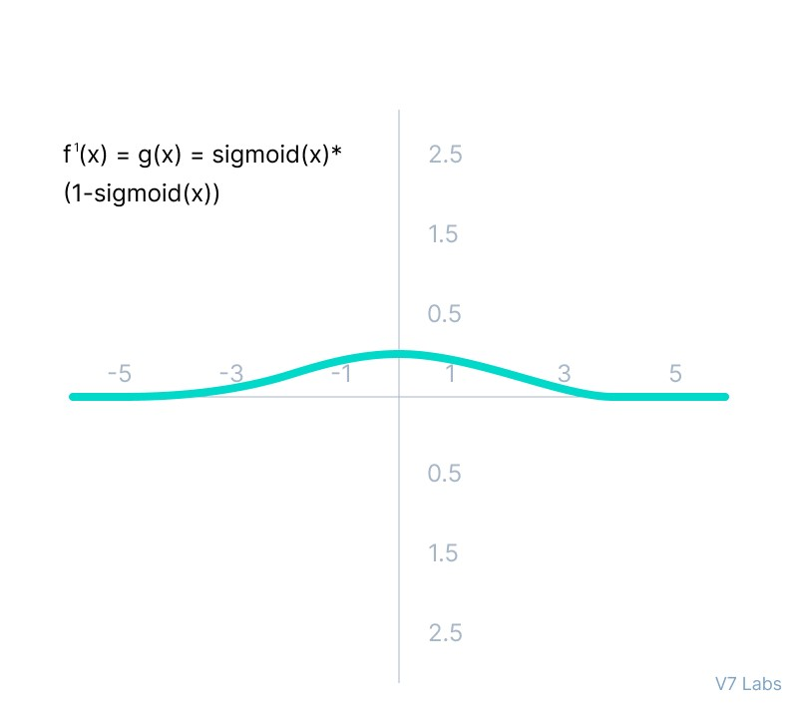
limitations of sigmoid
The derivative of the function is f'(x) = sigmoid(x)*(1-sigmoid(x)).
As we can see from the above Figure, the gradient values are only significant for range -3 to 3, and the graph gets much flatter in other regions.
It implies that for values greater than 3 or less than -3, the function will have very small gradients. As the gradient value approaches zero, the network ceases to learn and suffers from the Vanishing gradient problem.
The output of the logistic function is not symmetric around zero. So the output of all the neurons will be of the same sign. This makes the training of the neural network more difficult and unstable.
the gradient is strongest when the unit's output is near 0.5,

Slide 36
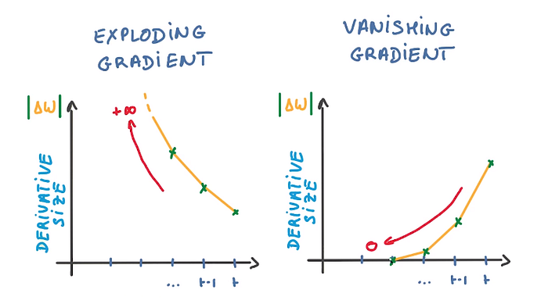
Vanishing gradient problem.
Vanishing Gradient Problem: Explained
1. What is the Vanishing Gradient Problem?
In deep neural networks, the gradients become too small as they are backpropagated from the output layer to the earlier layers.
When gradients approach zero, the early layers stop learning because their weights do not update significantly.
This slows down training or makes deep networks completely ineffective.
2. Why Does the Vanishing Gradient Problem Happen?
🔴 Saturating Activation Functions (Sigmoid, Tanh) → Their gradients are very small for extreme inputs, leading to almost zero weight updates.
🔴 Deep Networks → In very deep models, gradients shrink layer by layer during backpropagation.
🔴 Poor Weight Initialization → If weights are too small, they push activations into the saturation region, worsening the problem.
The main use case of the sigmoid function is as the activation for the output layer of binary classification models.
that why not use in Hidden layers
https://www.engati.com/glossary/vanishing-gradient-problem

Slide 37
3. Consequences of Vanishing Gradients
❌ Early layers stop learning, making training inefficient.
❌ The network fails to capture low-level features (important for image/text tasks).
❌ Deep networks struggle to converge to optimal solutions.
4. How to Overcome the Vanishing Gradient Problem?
✅ Use ReLU-based Activations → ReLU, Leaky ReLU, PReLU, and Swish avoid saturation and maintain strong gradients.
✅ Apply Batch Normalization → Keeps activations in an optimal range, preventing saturation.
✅ Use Better Weight Initialization →
Xavier Initialization (for Sigmoid/Tanh)
He Initialization (for ReLU-based activations)
✅ Use Residual Networks (ResNet) → Introduce skip connections, allowing gradients to bypass deep layers.
✅ Gradient Clipping → Limit the size of gradients to prevent them from shrinking too much.
5. Real-World Example: How ResNets Solve Vanishing Gradients
In very deep networks (e.g., ResNet-50, ResNet-101):
✔ Instead of just stacking layers, skip connections (shortcuts) are added.
✔ These allow gradients to flow directly to earlier layers.
✔ This prevents vanishing gradients and makes training deep networks feasible.
Would you like a code example demonstrating this issue and its solution? 🚀

Slide 38
Exploding Gradient Problem: Explained
1. What is the Exploding Gradient Problem?
In deep neural networks, gradients become too large as they backpropagate, causing unstable weight updates.
This makes the model unable to converge, resulting in overflowing values (NaN or Inf) in computations.
2. Why Does the Exploding Gradient Problem Happen?
🔴 Deep Networks → In very deep models, if weight updates are too large, they increase exponentially layer by layer.
🔴 High Learning Rates → Large updates amplify the problem, making the network unstable.
🔴 Improper Weight Initialization → If weights are initialized too large, they can grow uncontrollably.
🔴 Lack of Regularization → Without constraints, gradients can explode during training.

Slide 39
3. Consequences of Exploding Gradients
❌ Loss function diverges → Model fails to learn.
❌ Weights oscillate wildly → Training never stabilizes.
❌ NaN (Not-a-Number) errors → Training crashes.
4. How to Overcome the Exploding Gradient Problem?
✅ Use Gradient Clipping → Restrict gradients to a maximum threshold.
✅ Use Proper Weight Initialization →
Xavier Initialization (for Sigmoid/Tanh)
He Initialization (for ReLU-based activations)
✅ Reduce Learning Rate → Large updates cause instability.
✅ Use Batch Normalization → Normalizes activations, keeping gradients stable.
✅ Apply Regularization (L1/L2, Dropout) → Prevents uncontrolled weight growth.
✅ Use Skip Connections (ResNets, LSTMs) → Helps prevent both vanishing & exploding gradients.
5. Real-World Example: Exploding Gradients in RNNs (LSTMs to the Rescue!)
Standard RNNs suffer from exploding gradients because they process long sequences.
LSTMs (Long Short-Term Memory) networks solve this using gated mechanisms, preventing gradient explosion.
Would you like a practical example demonstrating gradient clipping in training? 🚀

Slide 40
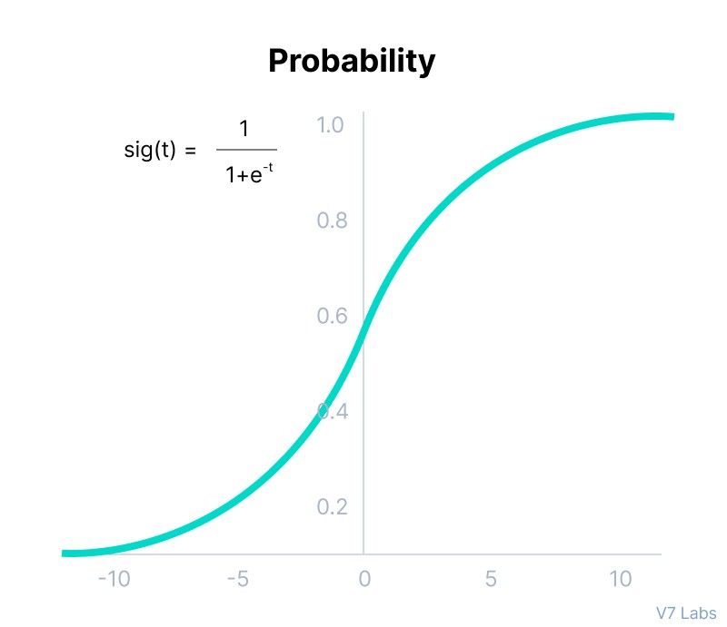
3. Softmax activation
Before exploring the ins and outs of the Softmax activation function, we should focus on its building block—the sigmoid/logistic activation function that works on calculating probability values.
‍The output of the sigmoid function was in the range of 0 to 1, which can be thought of as probability.
But—
This function faces certain problems.
Let’s suppose we have five output values of 0.8, 0.9, 0.7, 0.8, and 0.6, respectively. How can we move forward with it?
The answer is: We can’t.
The above values don’t make sense as the sum of all the classes/output probabilities should be equal to 1.
You see,
the Softmax function is described as a combination of multiple sigmoids.
It calculates the relative probabilities. Similar to the sigmoid activation function, the SoftMax function returns the probability of each class.
It is most commonly used as an activation function for the last layer of the neural network in the case of multi-class classification.
Extension of sigmoid activation function taking advantage of range of the output between 0 and 1. This is mainly used in the output layer of a multiclass, multinomial classification problem with a useful property of sum of the output probabilities adding up to 1.
To put it another way, this is applying a sigmoid to every neuron on the output and then normalizing it to a sum of 1.

Slide 41
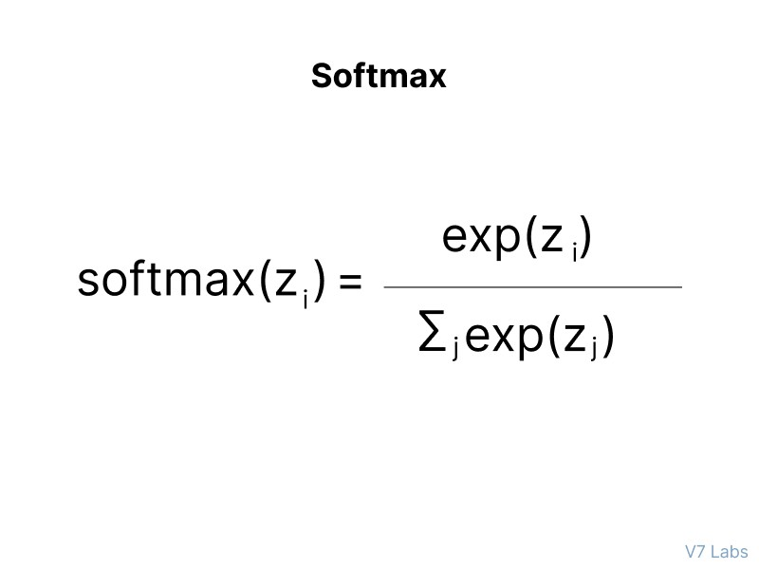
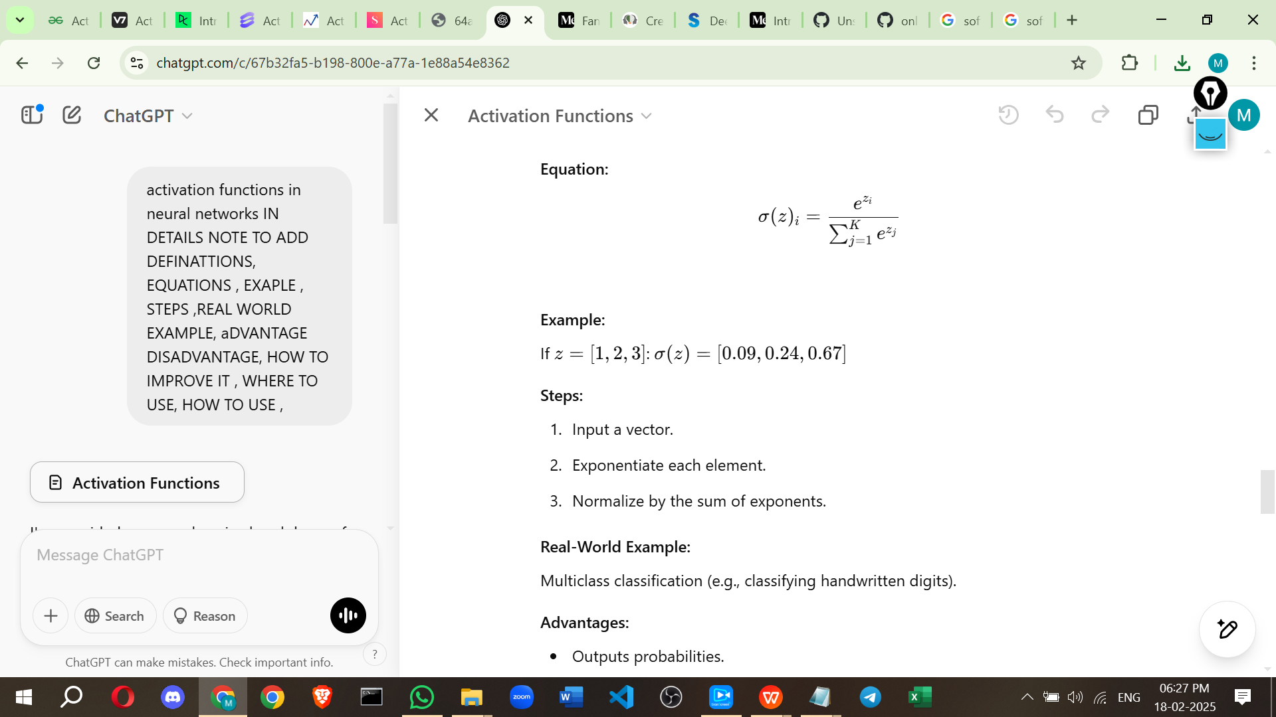
Mathematically it can be represented as:
Softmax Function
Let’s go over a simple example together.
Assume that you have three classes, meaning that there would be three neurons in the output layer. Now, suppose that your output from the neurons is [1.8, 0.9, 0.68].
Applying the softmax function over these values to give a probabilistic view will result in the following outcome: [0.58, 0.23, 0.19].
The function returns 1 for the largest probability index while it returns 0 for the other two array indexes.
Here, giving full weight to index 0 and no weight to index 1 and index 2. So the output would be the class corresponding to the 1st neuron(index 0) out of three.
You can see now how softmax activation function make things easy for multi-class classification problems.
The use of the exponential function ensures that all output values are non-negative. This is crucial because probabilities cannot be negative.
Softmax is typically used in the output layer of a neural network. (multi-class classification).
The probabilities produced by the softmax function can be interpreted as confidence scores for each class

Slide 42
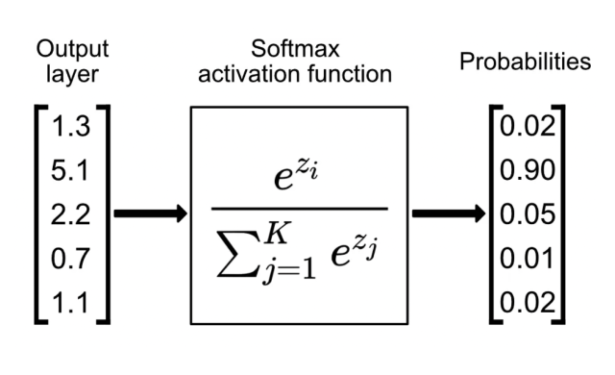
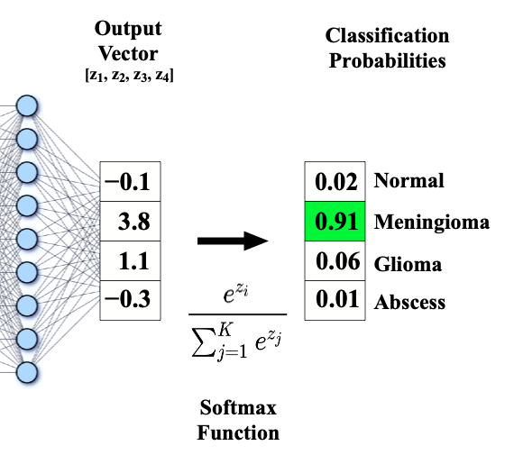
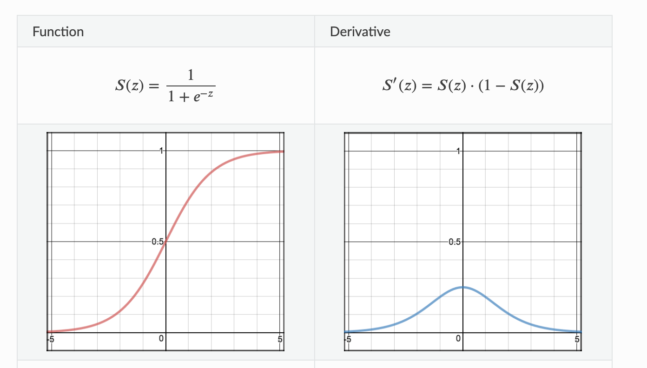
Real-World Example:
Multiclass classification (e.g., classifying handwritten digits).
Advantages:
Outputs probabilities.
Suitable for multiclass problems.
Disadvantages:
Sensitive to outliers.
How to Improve:
Use temperature scaling to control output confidence.
Where to Use:
Output layers for multiclass classification.
How to Use:
layer = tf.keras.layers.Dense(10, activation='softmax')

Slide 43
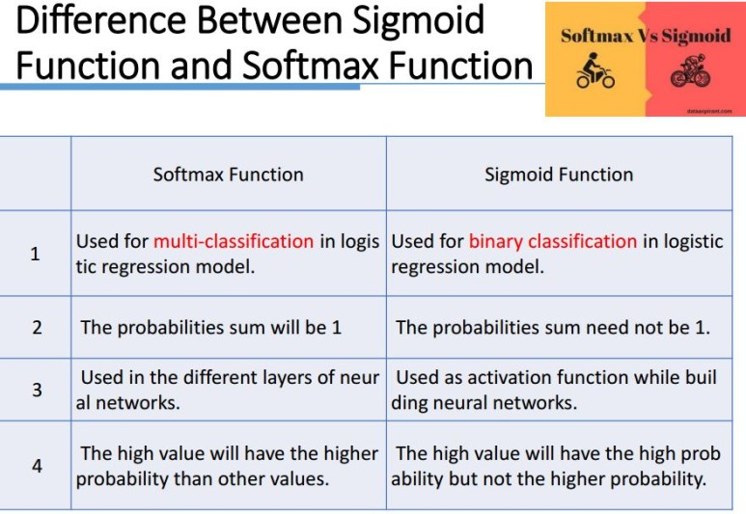
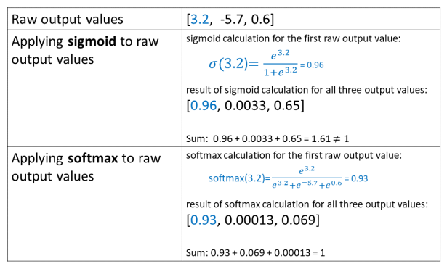
https://glassboxmedicine.com/2019/05/26/classification-sigmoid-vs-softmax/
https://medium.com/aidevnepal/for-sigmoid-funcion-f7a5da78fec2

Slide 44
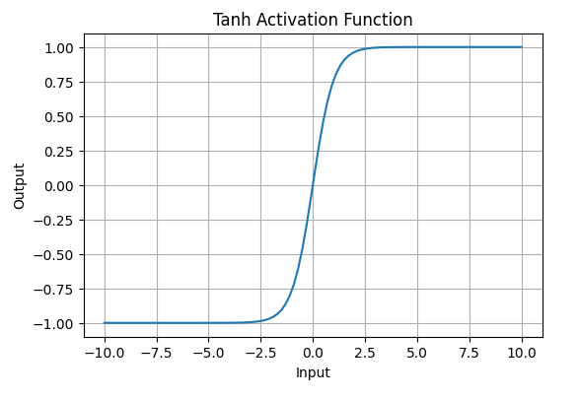

3. Tanh Activation

Slide 45
How does Tanh Work?
It takes an input xx and transforms it into a value between -1 and 1.
The function is S-shaped (sigmoid-like) but centered at 0, making it useful for balanced outputs.
It is differentiable, allowing for gradient-based optimization in neural networks.
Where is Tanh Used?
Hidden layers of deep learning models, especially RNNs (Recurrent Neural Networks).
In scenarios where zero-centered activation is needed to improve training stability.
In binary classification tasks when outputs range between -1 and 1.
When to Use Tanh?
When you need stronger gradients (compared to Sigmoid) for better learning in hidden layers.
When dealing with zero-centered data distributions.
When you want better gradient flow in deep networks compared to the Sigmoid function.
Why Use Tanh?
Zero-centered output helps in faster convergence during training.
Steeper gradients in the middle range (compared to Sigmoid) improve learning efficiency.
Better suited for hidden layers in some architectures compared to Sigmoid.

Slide 46
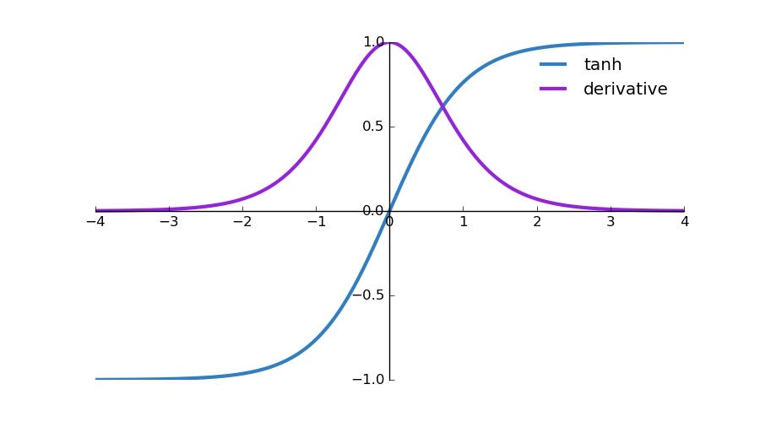
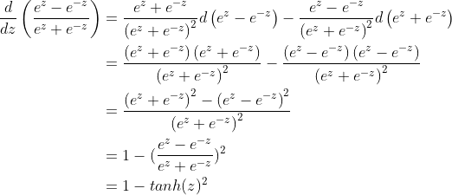
Advantages of Tanh
✅ Zero-centered output (-1 to 1) improves weight updates.
✅ Stronger gradients than Sigmoid, leading to better training speed.
✅ Useful in RNNs, making them more stable than Sigmoid-based networks.
Disadvantages of Tanh
❌ Suffers from vanishing gradient problem for large or small values of xx.
❌ Computationally expensive compared to ReLU.
❌ Not ideal for very deep networks, where ReLU or Leaky ReLU performs better.
Example in Python (Using Tanh in TensorFlow/Keras)
Real-World Example: Sentiment Analysis in Chatbots
A chatbot classifies user sentiment as positive or negative.
If the model uses Sigmoid, outputs range from (0 to 1), which is not ideal for balanced sentiment scoring.
Using Tanh (-1 to 1) ensures that negative sentiments have negative scores and positive ones have positive scores, making the classification more intuitive.
This helps the chatbot respond better based on user sentiment.
Would you like a comparison with ReLU and Sigmoid? 🚀

Slide 47
How to Overcome the Disadvantages of Tanh Activation Function?
Tanh has two main disadvantages:
Vanishing Gradient Problem (when inputs are too large or too small).
Computational Complexity (more expensive than ReLU).
1. Addressing the Vanishing Gradient Problem
When inputs are far from zero (very large or very small), the gradient of Tanh approaches zero, slowing down learning. To mitigate this:
✅ Use Batch Normalization – Helps keep inputs close to zero (where Tanh has strong gradients).
✅ Use Xavier (Glorot) Initialization – Helps prevent extreme values in weights, keeping activations in the useful range.
✅ Switch to ReLU or Leaky ReLU – These avoid vanishing gradients by allowing gradients for all positive values.
✅ Use Residual Connections (Skip Connections) – Helps bypass layers where gradients are small, improving learning in deep networks.
2. Addressing Computational Complexity
Since Tanh involves exponentials, it is more computationally expensive than ReLU. Solutions include:
✅ Use ReLU Instead – ReLU is computationally simpler and preferred for deep networks.
✅ Hybrid Approach (Tanh + ReLU) – Use Tanh in the first few layers (to get zero-centered activations) and switch to ReLU in deeper layers.
✅ Use Approximate Tanh Implementations – Hardware-optimized or lookup table-based implementations can speed up training.
Alternative: Swish or GELU
If you want an activation function that maintains smooth gradients like Tanh but avoids its weaknesses, consider:
Swish (x * sigmoid(x)) – Developed by Google, avoids vanishing gradients and works well in deep networks.
GELU (Gaussian Error Linear Unit) – Used in Transformer models like BERT for better performance.
Would you like to see a side-by-side comparison of these functions in a neural network? 🚀

Slide 48
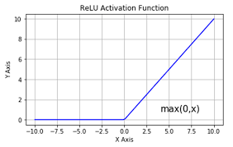


4. ReLU (Rectified Linear Unit) Activation Function
What is ReLU?
ReLU (Rectified Linear Unit) is an activation function commonly used in deep learning. It outputs zero for negative inputs and keeps positive inputs unchanged.Mathematically,
f(x)=max⁡(0,x) or f(x) = \max(0, x)
How does ReLU Work?
If xx is positive, the output is xx (identity function).
If xx is negative, the output is 0 (dead neuron).
Where is ReLU Used?
In hidden layers of deep learning models, especially CNNs & deep networks.
In image recognition, NLP, and speech processing models due to its efficiency.
When to Use ReLU?
When training deep networks (ReLU avoids the vanishing gradient problem).
When computational efficiency is a priority (faster than Sigmoid & Tanh).
When using CNNs, where ReLU has been proven effective.
Why Use ReLU?
Avoids vanishing gradients (compared to Sigmoid/Tanh).
Faster computation (simple max function).
Encourages sparsity, making networks more efficient.

Slide 49


Advantages of ReLU
✅ No vanishing gradient problem for positive values (better gradient flow).
✅ Computationally efficient (no exponentials like Sigmoid/Tanh).
✅ Sparsity (some neurons output 0, reducing unnecessary computations).
✅ Works well for deep networks (most deep learning models use ReLU).
Disadvantages of ReLU & How to Overcome Them
Disadvantage | Solution
Dying ReLU Problem (neurons output 0 for negative values and stop learning) | Use Leaky ReLU (f(x)=max⁡(0.01x,x)f(x) = \max(0.01x, x)) or Parametric ReLU (PReLU)
Unbounded Output (large values may cause instability) | Use Batch Normalization to normalize activations
Not Zero-Centered (can lead to inefficient weight updates) | Use Leaky ReLU or Swish, which are more balanced
Real-World Example: ReLU in Image Classification (CNNs)
In image recognition models like ResNet, VGG, and MobileNet, ReLU is used in convolutional layers to:
✅ Improve training speed
✅ Prevent vanishing gradients
✅ Enable deep networks to learn hierarchical features
Would you like a comparison of ReLU with Swish, GELU, or other activations? 🚀

Slide 50
Example in Python (Using ReLU in TensorFlow/Keras)
import numpy as np
import matplotlib.pyplot as plt
# Define ReLU function
def relu(x):
return np.maximum(0, x)
# Generate input values
x = np.linspace(-5, 5, 100)
y = relu(x)
# Plot ReLU function
plt.plot(x, y, label="ReLU Activation", color="blue")
plt.xlabel("Input")
plt.ylabel("Output")
plt.title("ReLU Activation Function")
plt.legend()
plt.grid()
plt.show()

Slide 51


5. Leaky ReLU (Leaky Rectified Linear Unit) Activation Function
What is Leaky ReLU?
Leaky ReLU is a modified version of ReLU that allows small gradients for negative inputs instead of zero. This helps prevent the "dying ReLU" problem, where neurons become inactive and stop learning.
Mathematically, f(x) =max⁡(αx,x)f(x) = \max(\alpha x, x)
where α\alpha (leak factor) is a small positive constant, typically 0.01.
How does Leaky ReLU Work?
If xx is positive, it behaves like ReLU (f(x)=xf(x) = x).
If xx is negative, it outputs a small fraction (αx\alpha x) instead of zero.
Where is Leaky ReLU Used?
In deep networks where dying ReLU is a concern.
In GANs (Generative Adversarial Networks) and CNNs for stable learning.
In models where some negative values should still contribute to learning.
When to Use Leaky ReLU?
When standard ReLU causes too many dead neurons (zero outputs).
When training deep networks that require better gradient flow.
When negative inputs still carry useful information.
Why Use Leaky ReLU?
Prevents dying neurons by allowing small negative gradients.
Helps deep networks learn faster and more effectively.
Works well for both image and NLP models.

Slide 52
Advantages of Leaky ReLU
✅ No dying ReLU problem (negative values have small gradients).
✅ Computationally simple (like ReLU, but with a small slope for negatives).
✅ Works well in deep networks and GANs.
Disadvantages of Leaky ReLU & How to Overcome Them
Disadvantage | Solution
Leak factor (α\alpha) is fixed (not adaptive) | Use Parametric ReLU (PReLU) where α\alpha is learned during training
May not always be the best choice (ReLU works well in many cases) | Try Swish or GELU, which are more adaptive
Still unbounded on the positive side (large activations may destabilize training) | Use Batch Normalization to normalize activations
Real-World Example: Leaky ReLU in GANs (Generative Adversarial Networks)
In GANs (used for image generation), standard ReLU can cause neurons to "die," making training unstable.
✅ Leaky ReLU ensures stable gradient flow in both the Generator and Discriminator.
✅ Prevents mode collapse (where GANs fail to generate diverse outputs).
✅ Used in DCGAN, CycleGAN, and StyleGAN for generating realistic images.
Would you like a comparison between Leaky ReLU, PReLU, and Swish? 🚀

Slide 53


Example in Python (Using Leaky ReLU in TensorFlow/Keras)
import numpy as np
import matplotlib.pyplot as plt
# Define Leaky ReLU function
def leaky_relu(x, alpha=0.01):
return np.where(x > 0, x, alpha * x)
# Generate input values
x = np.linspace(-5, 5, 100)
y = leaky_relu(x)
# Plot Leaky ReLU function
plt.plot(x, y, label="Leaky ReLU Activation", color="green")
plt.xlabel("Input")
plt.ylabel("Output")
plt.title("Leaky ReLU Activation Function")
plt.legend()
plt.grid()
plt.show()

Slide 54


6. Parametric ReLU (PReLU) Activation Function
What is Parametric ReLU (PReLU)?
PReLU is an improved version of Leaky ReLU where the leak factor (α\alpha) is not fixed but learned during training. This makes it adaptive, allowing the model to find the best negative slope for different neurons.
Mathematically,
f(x)=max⁡(αx,x)f(x) = \max(\alpha x, x)
where α\alpha is a trainable parameter rather than a fixed constant (like in Leaky ReLU).
How does PReLU Work?
If xx is positive, it behaves like ReLU (f(x)=xf(x) = x).
If xx is negative, it outputs αx\alpha x, but unlike Leaky ReLU, α\alpha is learned during training.
Where is PReLU Used?
In deep neural networks where activation adaptability improves performance.
In image processing (CNNs) and GANs, where dying ReLU is a problem.
In speech recognition and time-series forecasting.
When to Use PReLU?
When standard ReLU or Leaky ReLU does not perform well in a deep model.
When you want a trainable activation function that adapts dynamically.
When working with complex datasets that require fine-tuned activation behavior.
Why Use PReLU?
Learns the best negative slope (α\alpha) instead of using a fixed value.
Solves the dying ReLU problem dynamically.
Can improve accuracy in deep networks by making activation functions more flexible.

Slide 55
Advantages of PReLU
✅ Adaptive – Learns the best slope for negative values.
✅ Avoids the dying ReLU problem more effectively than Leaky ReLU.
✅ Improves model performance, especially in deep networks.
Disadvantages of PReLU & How to Overcome Them
Disadvantage | Solution
More parameters to learn (one α\alpha per neuron) | Use regularization techniques (e.g., L2 weight decay)
Risk of overfitting in small datasets | Use Leaky ReLU instead if your dataset is small
Still unbounded for positive inputs (can cause instability) | Apply Batch Normalization to stabilize training
Real-World Example: PReLU in Deep CNNs (e.g., ResNet, EfficientNet)
In deep CNNs like ResNet, PReLU is used to:
✅ Improve feature learning in deep convolutional layers.
✅ Prevent dead neurons dynamically, instead of using a fixed negative slope.
✅ Enhance performance in image classification and object detection.
Would you like a side-by-side comparison of PReLU with Leaky ReLU and Swish? 🚀

Slide 56

Example in Python (Using PReLU in TensorFlow/Keras)
import numpy as np
import matplotlib.pyplot as plt
from tensorflow.keras.layers import PReLU
# Define PReLU function
def prelu(x, alpha=0.01):
return np.where(x > 0, x, alpha * x)
# Generate input values
x = np.linspace(-5, 5, 100)
y = prelu(x, alpha=0.1) # Example with a learned alpha
# Plot PReLU function
plt.plot(x, y, label="PReLU Activation", color="purple")
plt.xlabel("Input")
plt.ylabel("Output")
plt.title("PReLU Activation Function")
plt.legend()
plt.grid()
plt.show()

Slide 57


https://uanurag6212.medium.com/activation-function-its-type-in-neural-network-part-2-6d9efffea62

Slide 58
Choosing the Right Activation Function
The choice of activation function depends on the type of problem you are trying to solve. Here are some guidelines:
For binary classification
Use the sigmoid activation function in the output layer. It will squash outputs between 0 and 1, representing probabilities for the two classes.
For multi-class classification
Use the softmax activation function in the output layer. It will output probability distributions over all classes.
If unsure
Use the ReLU activation function in the hidden layers. ReLU is the most common default activation function and usually a good choice.

Slide 59



Slide 60


Slide 62
References:
https://www.geeksforgeeks.org/activation-functions-neural-networks/
https://www.v7labs.com/blog/neural-networks-activation-functions
https://www.datacamp.com/tutorial/introduction-to-activation-functions-in-neural-networks
https://encord.com/blog/activation-functions-neural-networks/
https://www.analyticsvidhya.com/blog/2021/04/activation-functions-and-their-derivatives-a-quick-complete-guide/
https://www.superannotate.com/blog/activation-functions-in-neural-networks
chatgpt
https://blog.csdn.net/deephub/article/details/120234480
vvvi
https://blog.csdn.net/weixin_39910711/article/details/114849349

Slide 63
Gradient Descent
Revisiting Gradient Descent, Momentum Optimizer, RMSProp, Adam

Slide 64


Gradient Descent
The gradient descent algorithm is an optimization algorithm used to minimize an objective function, commonly called the cost or loss function in machine learning. This cost function is a mathematical function used to calculate loss or error which is the difference between the model’s predicted value and the actual value in the real world for a given input data set.
term “gradient descent” is derived from two key concepts: “gradient” and “descent.”
Gradient: In mathematics and physics, the gradient of a function at any point is a multi-dimensional vector that points in the direction of the steepest increase of that function.
Descent: The word “descent” refers to the method’s objective of moving downwards to find the minima of the function.
https://www.mathsisfun.com/gradient.html
https://vitalflux.com/gradient-descent-explained-simply-with-examples/
https://www.coursera.org/articles/what-is-gradient-descent

Slide 65
GRADIENT CODE
importnumpy as np
importmatplotlib.pyplot as plt
# Defining a simple quadratic function and its derivative
f =lambdax: x**2
f_prime =lambdax: 2*x
# Generating values
x =np.linspace(-10, 10, 400)
y =f(x)
# Gradient descent settings
learning_rate =0.15
x_start =9 # Starting point
steps =[x_start]
n_iterations =15
# Gradient Descent Iteration
for_ in range(n_iterations):
x_start =x_start -learning_rate *f_prime(x_start)
steps.append(x_start)
# Plotting the function
plt.figure(figsize=(10, 6))
plt.plot(x, y, lw=2, label=&amp;quot;f(x) =x²&amp;quot;)
# Plotting the steps
plt.scatter(steps, f(np.array(steps)), color='red', s=100, label='Steps')
plt.plot(steps, f(np.array(steps)), color='red', linestyle='--', lw=1.5)
# Annotations and labels
plt.title('Gradient Descent on f(x) = x²')
plt.xlabel('x')
plt.ylabel('f(x)')
plt.legend()
plt.grid(True)
plt.show()

Slide 66

Computation time is more in sgd and Computation cost is very high in batch what it means
SGD: Fast per-iteration, but may take more iterations (more time overall) and can be noisy due to updates based on individual samples. Works well for very large datasets and can be parallelized or used in online settings.
Batch Gradient Descent: More stable per iteration but computationally expensive, especially with large datasets. Can converge faster in terms of number of epochs but may take a long time per epoch.

Slide 67


Slide 70
Introduction to Types of Neural Networks
Deep learning includes various types of neural networks optimized for specific tasks:
Feedforward Neural Networks (FNN):
Basic architecture where information moves in one direction.
Used in classification and regression tasks.
Convolutional Neural Networks (CNN):
Specialized for image processing tasks.
Uses convolutional layers to detect spatial features.
Recurrent Neural Networks (RNN):
Designed for sequential data like time series and speech.
Uses loops and memory to retain information from previous inputs.
Long Short-Term Memory (LSTM):
A type of RNN that solves the vanishing gradient problem.
Used in text generation, language modeling, and speech recognition.
Generative Adversarial Networks (GANs):
Consist of a generator and a discriminator that compete to generate realistic data.
Used in AI-generated art, deepfake videos, and data augmentation.
https://www.geeksforgeeks.org/neural-networks-a-beginners-guide/

Slide 71

Feedforward Neural Networks (FNN):
the flow of information occurs in the forward direction. The input is used to calculate some intermediate function in the hidden layer, which is then used to calculate an output.
2. Backpropagation
- the weights of the network connections are repeatedly adjusted to minimize the difference between the actual output vector of the net and the desired output vector.
Implement the FNN
https://colab.research.google.com/drive/1z_nL3RcvR1x4uIR88VWEj8Zdr7mYEcQK#scrollTo=keCSdzvOrRmx

Slide 72
Introduction to TensorFlow and Keras
TensorFlow and Keras are two of the most widely used deep learning frameworks.
TensorFlow:
Developed by Google Brain.
Provides low-level and high-level APIs for building deep learning models.
Supports large-scale machine learning and deployment.
Keras:
High-level API built on TensorFlow.
Simplifies model building and experimentation.
Allows quick prototyping with minimal code.

Slide 73
TensorFlow code
What is TensorFlow?
TensorFlow is an end-to-end open-source machine learning platform with a focus on deep neural networks. Deep learning is a subtype of machine learning that analyses massive amounts of unstructured data. Since it works with structured data, deep learning is different from normal machine learning.
importtensorflowastfprint("TensorFlow version:",tf.__version__)
How to install TensorFlow ?
pip install tensorflow
If you have a good graphics card in your computer,
pip install tensorflow-gpu
Check Installation
import tensorflow as tf
print(tf.__version__)
Some TensorFlow Fundamentals

Slide 74
Some TensorFlow Fundamentals
a tensor is a multi-dimensional array of data that can be used to represent data and perform mathematical operations. Tensors are a generalization of vectors and matrices,
What are tensors used for?
Training neural networks: Tensors store the weights and parameters of neural networks, and are used in the algorithms that train them
Representing data: Tensors can represent data such as images, movies, sounds, and relationships between words
Clustering: Tensors can be used in clustering algorithms such as k-means clustering
Support vector machines: Tensors can represent data in support vector machines
Why are tensors important?
Tensors are efficient with memory, making them ideal for parallel computing environments
Tensors are versatile and efficient at handling data

Slide 75

What are tensors built from?
The values in a tensor contain identical data types with a specified shape. Dimensionality is represented by the shape. A vector, for example, is a one-dimensional tensor, a matrix is a two-dimensional tensor, and a scalar is a zero-dimensional tensor.
import tensorflow as tf
x=tf.constant([[1.,2.,3.],[4.,5.,6.]])
print(x)
print(x.shape)
print(x.dtype)

Slide 76

Shape
In the TensorFlow Python library, the shape corresponds to the dimensionality of the tensor. In simple terms, the number of elements in each dimension defines a tensor’s shape.

